Slide 1
Removal of Dye from Textile Waste
Group Members:
Anshul Bhandari (13BCH0001)
Divyansh Bhuwalka (13BCH0002)
Kritika Kashyap (13BCH0011)
Shreya Sengupta (13BCH0012)
Karan Sarpal (13BCH0034)

Slide 2
INTRODUCTION
Dyes can be extracted from a material using non-polar solvents like Petroleum Ether, Dichloromethane, Chloroform and Hydrogen peroxide.
Ultraviolet Radiation of varying wavelengths were passed through the textile waste water inside a UV Chamber leading to adsorption on ZnO.
COLORIMETRY technique is made use of to determine the amount of dye removed from the material and hence compare the efficiency of the solvents.
Based on the experimental observations, graphs of time and temperature v/s Transmittance(%I) and Optical Density(O.D.) were plotted with the calculation of the correlation coefficient of the data. Graph showing adsorbance with varying wavelength has also been shown with different diameters of grain.
The correlation coefficient of the data obtained is also found.

Slide 3
Methodology- TEST 1
TIME DEPENDENCY
STEP 1
Square pieces of 2×2cm were cut from a violet coloured waste dyed cotton cloth.
STEP 2
15 ml of Chloroform/DCM/H₂O₂ solution was poured into a beaker .
STEP 3
The mixture containing Chloroform/DCM/H₂O₂ and the separated dye was taken out in intervals of 5 minutes and tested by putting in a COLORIMETER using a cuvette.
The cloth piece was now added into it and was stirred gently.

Slide 4
OBSERVATIONS
Test-1
CHLOROFORM
Time (min) | % I | Optical Density
0 | 99 | 0
5 | 92 | 0.03
10 | 89 | 0.04
15 | 88 | 0.06
20 | 86 | 0.07
25 | 84 | 0.08
30 | 78 | 0.11
35 | 73 | 0.13
40 | 70 | 0.15

Slide 5
Test 1- Chloroform

Slide 6
DICHLORO METHANE
Time (min) | % I | Optical Density
0 | 98 | 0
3 | 84 | 0.07
6 | 79 | 0.10
9 | 75 | 0.11
12 | 74 | 0.12
15 | 72 | 0.14
18 | 70 | 0.15
21 | 68 | 0.16
24 | 67 | 0.17
27 | 64 | 0.19
30 | 60 | 0.21

Slide 7
Test 1- DCM

Slide 8
HYDROGEN PEROXIDE
TIME | %I | O.D.
0 | 99 | 0
5 | 88 | 0.05
10 | 84 | 0.07
15 | 80 | 0.08
20 | 76 | 0.11
25 | 73 | 0.13
30 | 69 | 0.16
35 | 66 | 0.18
40 | 62 | 0.2

Slide 9
Test 1- H₂O₂

Slide 10
Result for Test 1
As time increases, the quantity of dye extracted increases.
A linear increase in Optical Density (O.D.) and a linear decrease in percentage Intensity (%I) of the solution is observed with increase in time.
Values of correlation coefficient (r²) are calculated and found to be close to 1 indicating the linear relationship of variables.

Slide 11
Methodology- TEST-2
TEMPERATURE DEPENDENCY
STEP 1
Square pieces of 2×2cm were cut from a violet coloured waste dyed cotton cloth.
STEP 2
15 ml of DCM solution was poured into a beakers .
STEP 3
The solution was kept for a constant 1 minute and tested by putting in a COLORIMETER.
The cloth piece was then added into it and is kept on a heating plate until the solution temperature reached 30˚C and then removed from the heater.

Slide 12
Test-2 Solvent used: DCM
Temp (ºC) | % I | Optical Density
30 | 62 | 0.2
32 | 60 | 0.22
34 | 55 | 0.26
36 | 46 | 0.34
38 | 43 | 0.37
39.5 (Boiling Point) | 42 | 0.38

Slide 13
Test 2

Slide 14
Result for Test 2
As temperature increases, the quantity of dye extracted increases.
A linear increase in Optical Density (O.D.) and a linear decrease in percentage Intensity (%I) of the solution is observed with increase in temperature.
Values of correlation coefficient (r²) are calculated and found to be close to 1 indicating the linear relationship of variables.

Slide 15
Methodology- TEST-3
SIZE DEPENDENCY
STEP 1
A solution containing 30 ml water and 3 ml methyl orange was prepared in 5 beakers.
STEP 2
2 grams Zinc Oxide of varying sizes was then added to the solution.
STEP 3
The above granules in the solution were subjected to UV spectrum and the solution was tested by using a colorimeter for checking amount of colour adsorbed.

Slide 16
Test-3
Time Constant at 10 minutes
Wavelength of 365 nm
SIZE | %I | O.D.
3.175 | 36 | 0.4
2.27 | 49 | 0.31
1.32 | 66 | 0.18
0.626 | 81 | 0.08
0 | 88 | 0.05

Slide 17
Test 3

Slide 18
Result for Test 3
As size decreases, the quantity of dye extracted increases.
A polynomial increase of degree two was observed in Optical Density (O.D.) and a polynomial decrease of degree two in percentage Intensity (%I) of the solution is observed with decrease in diameter size.
Values of correlation coefficient (r²) are calculated and found to be close to 1 indicating the degree 2 relationship of variables.

Slide 19
Methodology- TEST-4
TIME DEPENDENCY
STEP 1
A solution containing 30 ml water and 3 ml methyl orange was prepared.
STEP 2
2 grams Zinc Oxide was then added to it.
STEP 3
The above granules and solution mixture was subjected to UV spectrum and the solution was tested by using a colorimeter for checking amount of colour adsorbed as time increased.

Slide 20
Test-4
Size constant at 3.175 mm
Wavelength of 365 nm
TIME(min) | %I | O.D.
10 | 36 | 0.4
20 | 43 | 0.36
30 | 51 | 0.30
40 | 61 | 0.21
50 | 74 | 0.13
60 | 89 | 0.05

Slide 21
Test 4

Slide 22
Result for Test 4
As time increases, the quantity of dye extracted increases.
A polynomial decrease in Optical Density (O.D.) and a polynomial increase in percentage Intensity (%I) of the solution is observed with increase in time.
Values of correlation coefficient (r²) are calculated and found to be close to 1 indicating the linear relationship of variables.

Slide 23
Methodology- TEST-5
WAVELENGTH DEPENDENCY
STEP 1
A solution containing 30 ml water and 3 ml methyl orange was prepared.
STEP 2
2 grams Zinc Oxide was then added to it.
STEP 3
The above granules and solution mixture was subjected to UV spectrum and the solution was tested by using a colorimeter for checking amount of colour adsorbed as time increased.

Slide 24
Test-5
Size constant at 3.175 mm
Varying wavelength
Wavelength (nm) | %I | O.D.
365 | 36 | 0.4
254 | 31 | 0.45
Sunlight (100 - 400) | 23 | 0.53

Slide 25
Result for Test 5
As wavelength of UV light increases, the quantity of dye adsorbed increases.
An increase in Optical Density (O.D.) and a decrease in percentage Intensity (%I) of the solution is observed with decrease in wavelength of UV light.
Due to high scattering of UV light, a comparatively high Optical Density was obtained in the presence of sunlight.

Slide 26
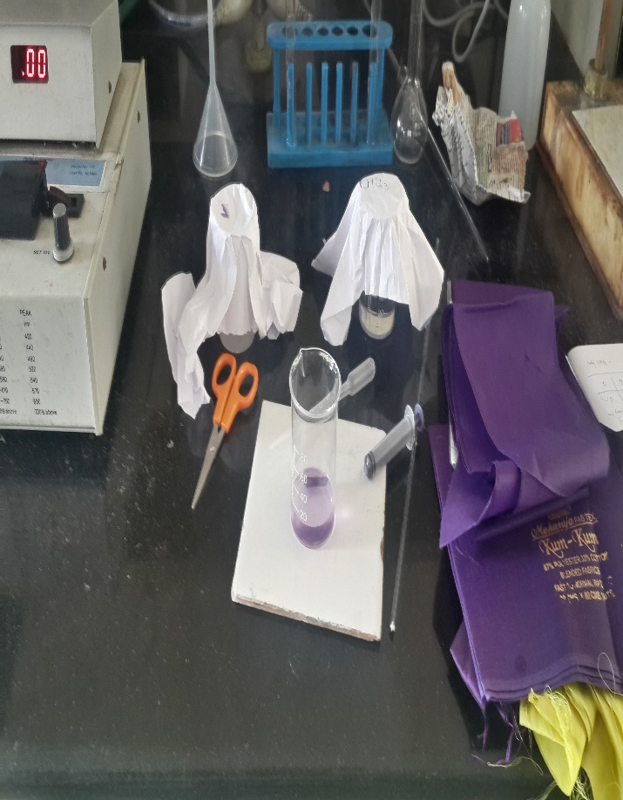
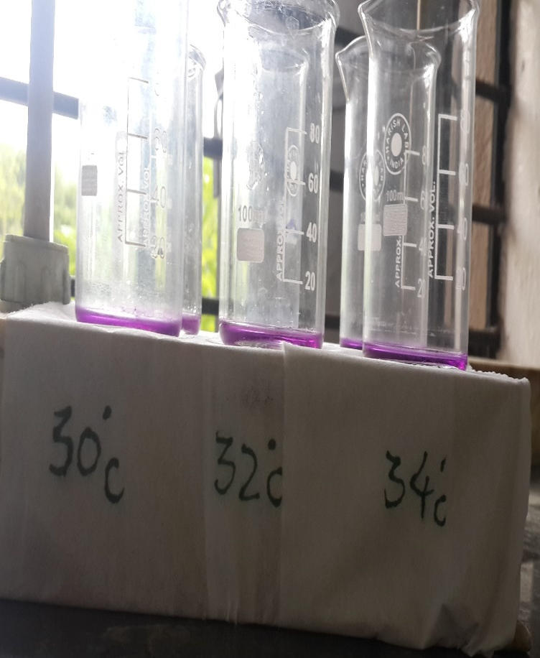
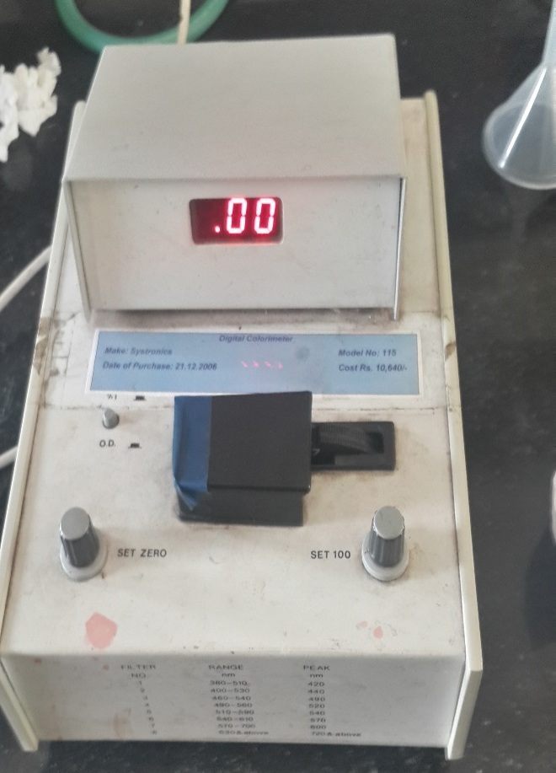
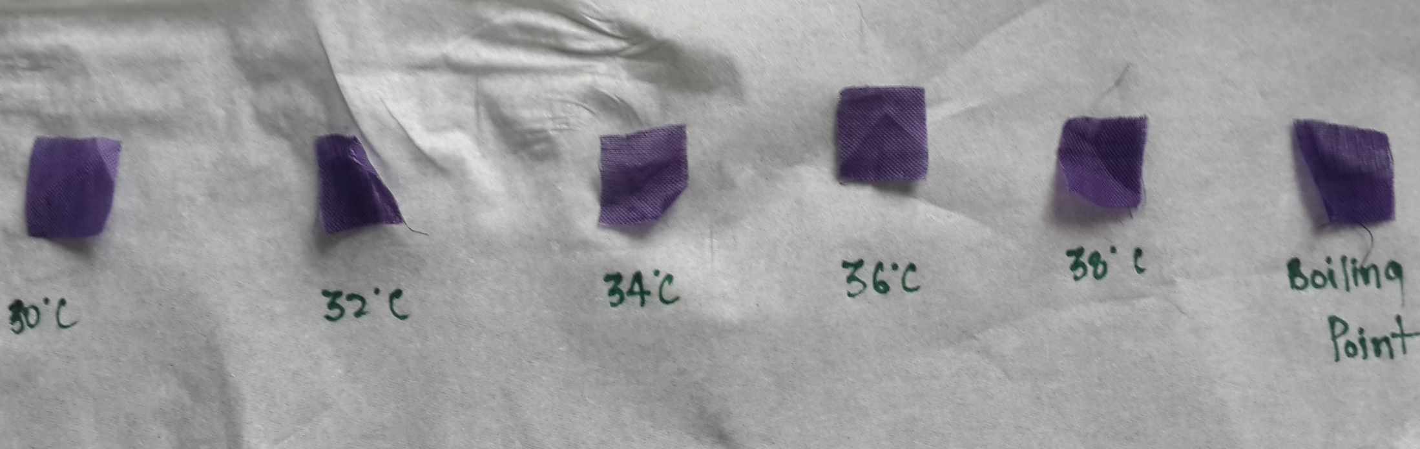

Slide 27
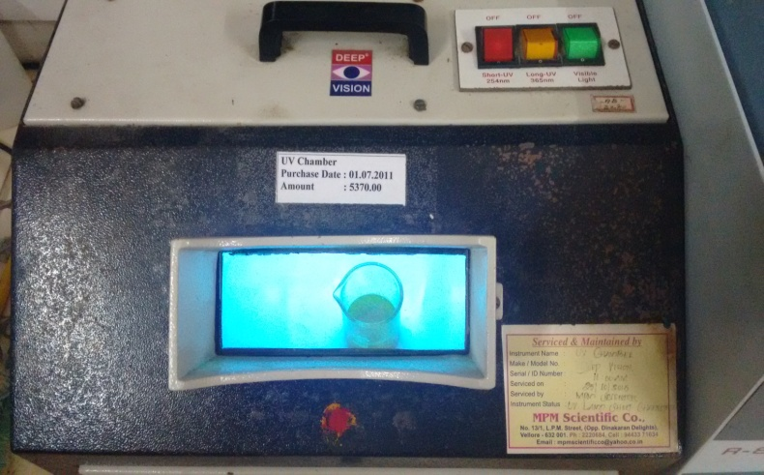
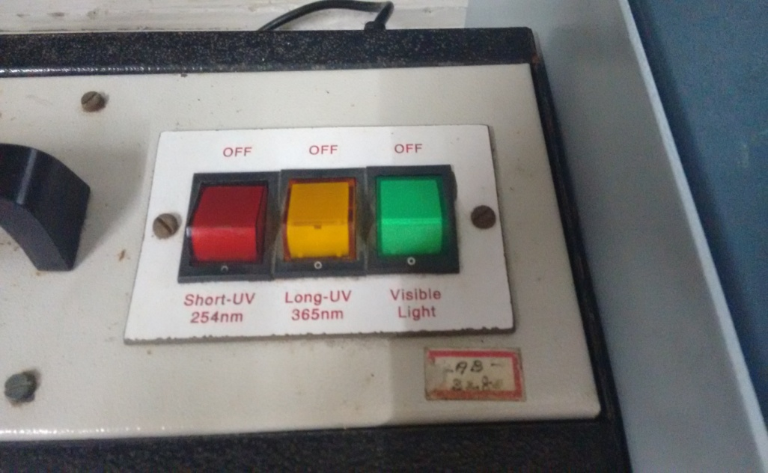
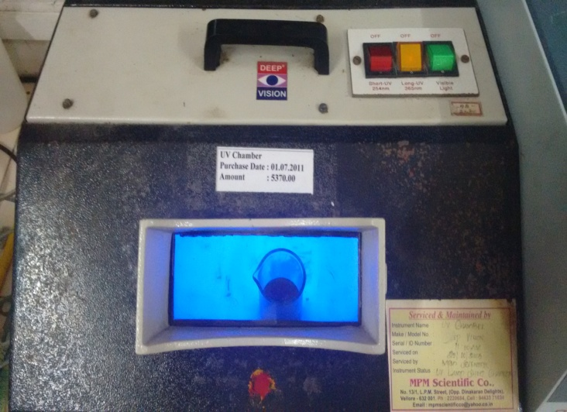
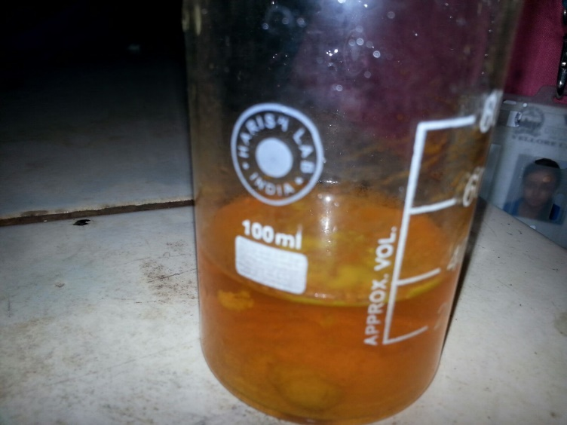
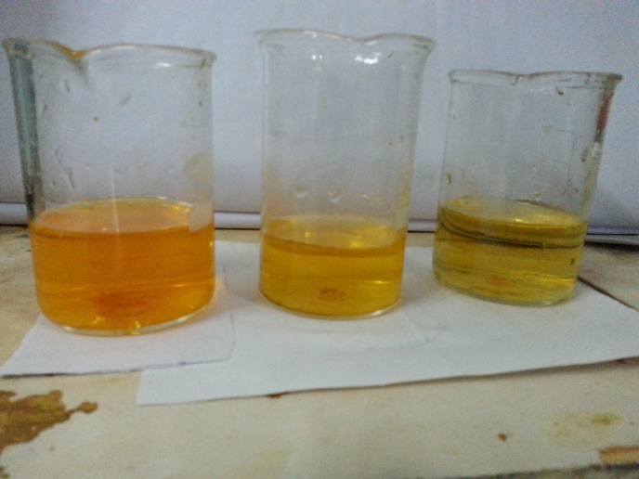

Slide 28
Conclusion
Textile waste is broadly classified as solid and liquid (waste water) waste. In tests 1 and 2, solid textile waste has been used for extracting the dye using a suitable solvent. With increase in time and temperature, the amount of dye removed from the cloth increased in all the polar solvents used. Highest rate of dye extraction was observed when Dichloromethane was used as the solvent.
In the Tests 3 and 4, textile waste water was used. Photocatalytic properties of ZnO as an adsorbent has been tested. On a large scale, this process is not feasible due to specification of the dye and high costs involving separation technique.
Scaling down the grain size of ZnO, increases the rate of adsorption. If the size is reduced to nano scale, then an appreciable increase in the adsorption can be expected.

Slide 29


